Slide 1
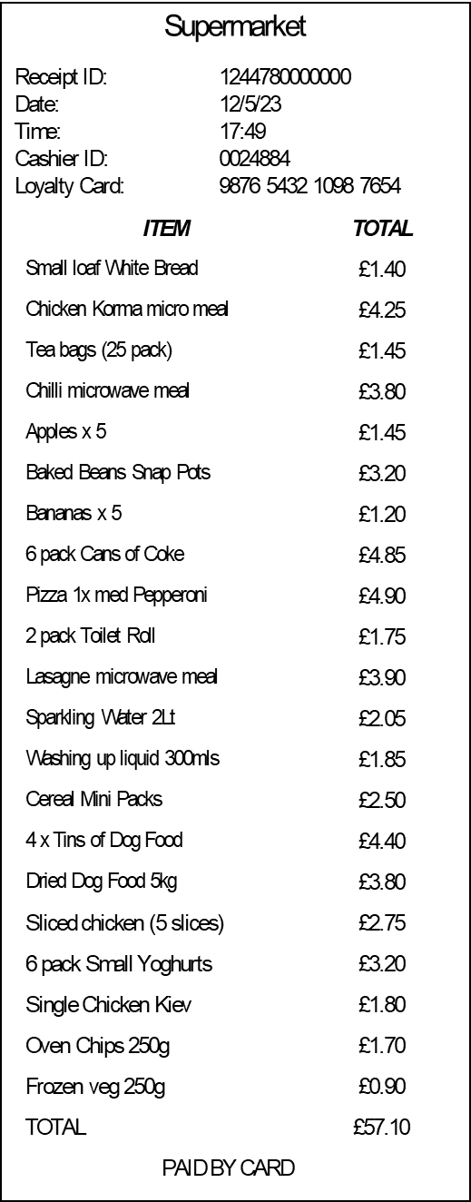

Slide 2
Supermarket
Supermarket
Receipt ID: 1244660000000
Date: 12/5/23
Time: 11:23
Cashier ID: 0024884
Loyalty Card: 1234 5678 9012 3456
Receipt ID: 1244780000000
Date: 12/5/23
Time: 17:49
Cashier ID: 0024884
Loyalty Card: 9876 5432 1098 7654
ITEM | TOTAL
Wholemeal Bread x 2 | £2.30
50:50 Sliced Bread | £1.45
Orange Diluting Juice 1Lt | £2.55
Size 3 Nappies (24 pack) | £5.60
Toothpaste (Age 6 – 9) | £1.95
Apples x 2 packs | £2.50
Satsumas x 2 packs | £3.20
Bananas x 10 | £2.10
Coffee 1kg | £5.60
Pizza 2 x large Margarita | £4.90
Pizza 1 x large Pepperoni | £2.75
24 pack Toilet Roll | £5.50
Carrots 1kg | £1.80
Baking potatoes (6 pack) | £1.70
Shreddies (XL pack) | £4.00
6 Chicken Breasts | £5.90
Beef mince 1kg | £3.60
4 pack Tinned Tomatoes | £4.20
8 pack Raspberry Jelly | £4.60
Sliced cheese x 2 packs | £4.00
Sliced ham x 2 packs | £3.90
Cat Litter 25kg | £14.85
Size 6 Pull Up Nappies (12 pack) | £2.75
Curry Sauce 300mls | £2.85
Spaghetti 2 x 500g | £2.10
Washing pods XL pack | £11.50
Dishwasher Tablets XL pack | £10.90
Chocolate biscuits – Twin pack | £2.55
TOTAL | £121.60
PAID BY CARD
ITEM | TOTAL
Small loaf White Bread | £1.40
Chicken Korma micro meal | £4.25
Tea bags (25 pack) | £1.45
Chilli microwave meal | £3.80
Apples x 5 | £1.45
Baked Beans Snap Pots | £3.20
Bananas x 5 | £1.20
6 pack Cans of Coke | £4.85
Pizza 1x med Pepperoni | £4.90
2 pack Toilet Roll | £1.75
Lasagne microwave meal | £3.90
Sparkling Water 2Lt | £2.05
Washing up liquid 300mls | £1.85
Cereal Mini Packs | £2.50
4 x Tins of Dog Food | £4.40
Dried Dog Food 5kg | £3.80
Sliced chicken (5 slices) | £2.75
6 pack Small Yoghurts | £3.20
Single Chicken Kiev | £1.80
Oven Chips 250g | £1.70
Frozen veg 250g | £0.90
TOTAL | £57.10
PAID BY CARD
Editable versions

